Slide 1

Introduction to Scrum
Notes:
Scrum is like a playbook for teams to work together better. It helps tackle tricky projects by breaking them into smaller parts and focusing on what's most important. It's all about being flexible and learning as we go. Scrum has five key values: Commitment, Focus, Openness, Respect, and Courage. Teams work in short bursts called Sprints, where they get things done fast. They meet often to talk about what's going well and what needs improvement. Scrum gives a clear view of progress, making teamwork smoother and goals easier to achieve.

Slide 2
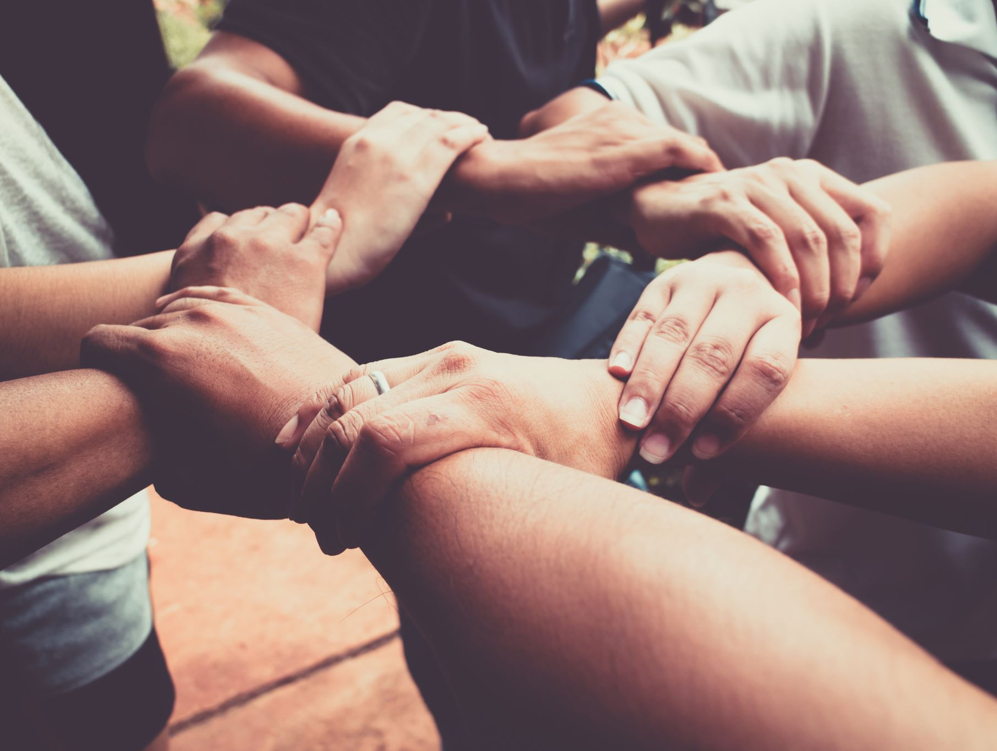
Welcome!
Welcome, ladies and gentlemen
Today, we'll dive into the world of Scrum, a powerful framework that can revolutionize how we work and achieve our goals
Notes:
"Good day, everyone. Today, we'll explore Scrum, a game-changing framework for achieving goals efficiently. It promotes teamwork, adaptability, and clear progress tracking. Let's delve in."

Slide 3

Purpose of the Scrum Guide
The Scrum Guide, developed in the early 1990s, is our roadmap to understanding Scrum
It defines Scrum's elements, rules, and principles essential for delivering value effectively
Notes:
"The Scrum Guide, created in the 1990s, is our trusty map to unlock Scrum's potential. It lays out Scrum's core elements, rules, and guiding principles, all vital for delivering value efficiently. This document evolves with the ever-changing landscape, making Scrum adaptable to various domains. It's a compass that ensures we stay on course towards effective value delivery."

Slide 4

Scrum Definition
Scrum is a lightweight framework designed for adaptive solutions to complex problems
It revolves around four core activities: Product Backlog, Sprint, Inspection, and Adaptation
Notes:
Scrum, a nimble framework, is your ally in tackling complex problems with agility. At its core, Scrum centers around four essential activities that drive results.
Firstly, we have the 'Product Backlog.' Think of it as your to-do list, but smarter. It's an ever-evolving repository of what needs to be done, continuously refined to maximize its value.
Next up is the 'Sprint.' Picture this as a focused, time-boxed effort, typically lasting a month or less. It's where the magic happens, turning items from the Product Backlog into a valuable Increment.
Now, 'Inspection.' Regularly checking and evaluating progress. It ensures that we're on the right path and allows us to spot issues early, keeping our efforts on track.
Lastly, 'Adaptation.' When we detect deviations or problems, we adjust swiftly. It's about continuous improvement, making sure we're always moving forward.
So, Scrum is your dynamic companion, offering a structured yet flexible approach to conquer complexity and deliver value effectively."

Slide 5

Scrum Theory
Scrum is grounded in empiricism and lean thinking
It emphasizes learning from experience and focuses on reducing waste, making it highly efficient and effective
Notes:
Scrum, the foundation of modern project management, stands firmly on two powerful pillars: empiricism and lean thinking.
Firstly, let's talk about empiricism. Scrum is all about learning from experience. It believes that knowledge is gained through real-world practice and decisions based on observations. By emphasizing empiricism, Scrum encourages teams to be in touch with reality, making informed choices, and adapting swiftly. It's like a continuous feedback loop, where each action informs the next, leading to refined processes and outcomes.
Secondly, we have lean thinking. Scrum is highly efficient because it's rooted in this principle. Lean thinking is all about minimizing waste and focusing solely on what adds value. In Scrum, you'll find no room for unnecessary meetings, tasks, or features. Everything is streamlined to deliver the maximum benefit with the least effort.
So, in essence, Scrum is your beacon to efficiency and effectiveness. It's a framework that harnesses the power of empiricism and lean thinking, guiding you toward success by leveraging your experiences and eliminating wasteful practices. Embrace Scrum, and you'll find yourself on a path to improved outcomes and productivity.

Slide 6
Scrum Values
Scrum embraces five core values: Commitment, Focus, Openness, Respect, and Courage
These values guide Scrum teams in their work and interactions
Notes:
Scrum, the dynamic framework for achieving goals, is not just about processes and practices; it's deeply rooted in a set of five core values that shape how Scrum teams operate. These values are Commitment, Focus, Openness, Respect, and Courage.
Commitment: Scrum teams commit to achieving their goals. This commitment is not just about meeting deadlines; it's a dedication to delivering high-quality work. Each team member commits to supporting one another, fostering a collaborative environment where everyone is aligned towards a common objective.
Focus: Focus is about zeroing in on what truly matters. In Scrum, teams prioritize their work ruthlessly, concentrating on tasks that bring the most value. Distractions are minimized, ensuring that the team's energy is channeled into tasks that drive progress.
Openness: Scrum thrives on transparency and open communication. Teams are encouraged to be open about their work and challenges. This openness fosters trust within the team and with stakeholders, leading to better collaboration and problem-solving.
Respect: Respect is at the heart of Scrum. Team members respect each other's abilities, opinions, and contributions. This mutual respect results in a supportive atmosphere where everyone feels valued and empowered to share their ideas.
Courage: Scrum encourages teams to have the courage to do the right thing, even when it's difficult. This means addressing issues head-on, taking calculated risks, and making decisions that benefit the team and the project.
These five values serve as a compass for Scrum teams, guiding their actions and interactions. They create a culture of collaboration, accountability, and continuous improvement. When Scrum teams embrace these values, they not only deliver better results but also enjoy a more fulfilling and effective work experience.

Slide 7

Scrum Team
The Scrum Team is the heart of Scrum, consisting of a Product Owner, Developers, and a Scrum Master
This cross-functional, self-managing team collaborates to achieve a common goal
Notes:
The Scrum Team lies at the core of the Scrum framework, and it's a powerhouse of collaboration. This team is a well-rounded trio, comprising a Product Owner, Developers, and a Scrum Master.
Within this cross-functional and self-managing unit, there are no hierarchies or sub-teams. They're all united by a singular purpose: achieving a shared goal, known as the Product Goal. It's about fostering a cohesive group of professionals who come together to tackle complex tasks, combining their unique skills and expertise.
This tight-knit collaboration within the Scrum Team ensures that everyone is on the same page, working harmoniously towards the same objective. Together, they are the driving force behind Scrum's success in delivering value effectively and efficiently.

Slide 8

Scrum Events
Scrum includes five key events: Sprint, Sprint Planning, Daily Scrum, Sprint Review, and Sprint Retrospective
These events provide structure and enable transparency throughout the Sprint
Notes:
First on the list is the 'Sprint.' It's like the heartbeat of Scrum, a time-boxed effort where the magic happens. Sprints are typically a month or less and provide a consistent cadence for the team.
Then comes 'Sprint Planning.' This is where the Product Owner and Developers collaborate to define what work should be tackled during the Sprint. It's about setting clear objectives and priorities.
Every day, the team gathers for the 'Daily Scrum.' This short and focused meeting allows team members to discuss progress, align their efforts, and identify any roadblocks. It's all about keeping the team in sync.
At the end of the Sprint, we have the 'Sprint Review.' Here, the Scrum Team showcases what they've achieved during the Sprint to key stakeholders. It's a working session, not just a presentation, and it ensures that everyone is on the same page.
Lastly, we have the 'Sprint Retrospective.' This event is all about continuous improvement. The team reflects on what went well, what could be improved, and makes actionable plans for the next Sprint.
These five events are the pillars of Scrum, providing the structure and transparency needed to deliver value effectively. They keep the team focused, ensure regular inspection, and drive adaptation to make each Sprint better than the last.

Slide 9

The Sprint
Sprints are the heartbeat of Scrum, lasting a fixed duration
They ensure predictability, quality, and a regular inspection of progress
Notes:
In Scrum, Sprints are the rhythmic heartbeat that keeps the framework pulsing with productivity and purpose. These fixed-duration time boxes, typically a month or less, bring a sense of predictability to the process. They serve as a commitment to deliver value within a defined timeframe.
During a Sprint, the Scrum Team focuses on creating a valuable Increment while maintaining quality standards. This regular cadence allows for a continuous inspection of progress, ensuring that the work aligns with the Sprint Goal. Sprints enable us to adapt and respond to changes efficiently. Like the steady rhythm of a heartbeat, Sprints provide the essential structure for Scrum's success, keeping the team on track and moving forward.

Slide 10

Sprint Planning
Sprint Planning initiates a Sprint by defining a Sprint Goal and selecting items from the Product Backlog
The team collaboratively plans how to achieve the goal
Notes:
Sprint Planning is the launchpad for a successful Sprint in Scrum. It's where the magic begins as the Scrum Team gathers to shape the upcoming journey.
During this crucial event, two essential activities take place. First, the Product Owner outlines why the upcoming Sprint is valuable, providing a clear sense of purpose through the Sprint Goal. This sets the team's sights on a common objective that aligns with the overall product vision.
Secondly, the Scrum Team collaborates to determine how to turn items from the Product Backlog into a valuable Increment. They evaluate what can be achieved within the Sprint and create a plan, often breaking down items into smaller, manageable tasks. This collaborative effort ensures that everyone understands their roles and responsibilities in achieving the Sprint Goal.
Sprint Planning is not just a meeting; it's the blueprint for the entire Sprint. It creates focus, clarity, and a shared commitment to delivering value. With a well-defined Sprint Goal and a clear plan, the Scrum Team embarks on their journey with confidence, ready to make a meaningful impact.

Slide 11

Daily Scrum
The Daily Scrum is a short, daily meeting for the Developers to inspect progress and adapt their plan for the day
It enhances communication, decision-making, and self-management
Notes:
The Daily Scrum, a brief daily gathering of the Developers, is like a compass that keeps the Scrum Team on course. In just 15 minutes, they inspect their progress, share updates, and adapt their plan for the day. This daily ritual promotes open communication, swift decision-making, and empowers self-management. It's a vital checkpoint that ensures everyone is aligned and focused on the Sprint Goal. By fostering collaboration and transparency, the Daily Scrum sets the team up for success, helping them navigate the complexities of their work effectively.

Slide 12

Sprint Review
The Sprint Review inspects the outcomes of the Sprint and allows stakeholders to provide feedback
It's a working session to discuss progress and adjust the Product Backlog
Notes:
The Sprint Review, a pivotal event in Scrum, is where we showcase the fruits of our labor from the Sprint. It's a dynamic working session where the Scrum Team presents what they've accomplished, inviting stakeholders to inspect the outcomes and offer feedback. This open dialogue is crucial for ensuring that the product aligns with stakeholder expectations. Together, we review what went well, what didn't, and adapt the Product Backlog accordingly. It's a collaborative step towards continuous improvement and product evolution, making the Sprint Review a cornerstone of Scrum's success.

Slide 13
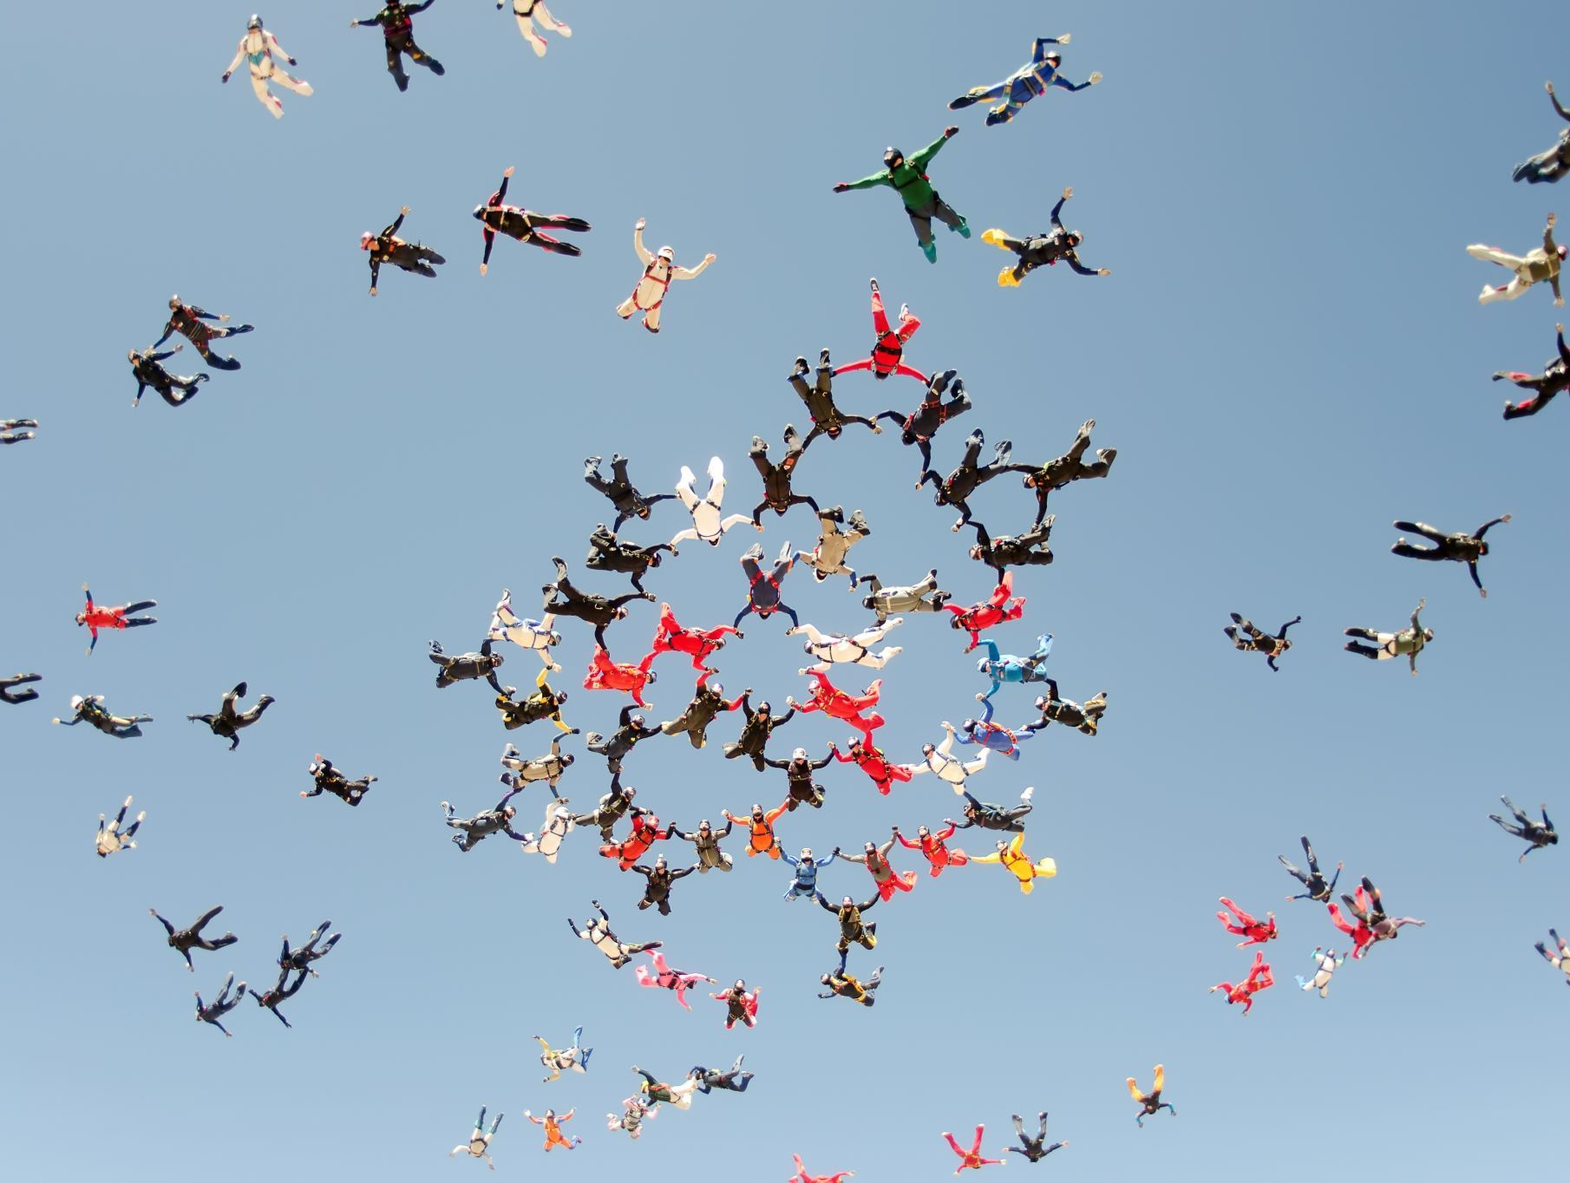
Sprint Retrospective
The Sprint Retrospective focuses on improving the Scrum Team's quality and effectiveness
It identifies what went well, problems encountered, and actionable improvements
Notes:
In the Sprint Retrospective, we turn our gaze inward, focusing on the continuous improvement of the Scrum Team. This vital event is a dedicated space to reflect on the Sprint, highlighting what went smoothly, the challenges we faced, and most importantly, actionable ways to enhance our quality and effectiveness. It's an open, blame-free discussion that fosters a culture of learning and growth. By identifying and implementing improvements, we ensure that each Sprint is better than the last. The Sprint Retrospective is where we fine-tune our Scrum practices, making it a key driver of our success.

Slide 14
Scrum Artifacts
Scrum artifacts, including Product Backlog, Sprint Backlog, and Increment, provide visibility and transparency into work
They are essential for achieving the Product Goal
Notes:
Scrum artifacts are the building blocks of transparency and visibility in our Scrum journey. They play a crucial role in helping us achieve the ultimate target: the Product Goal.
First, we have the Product Backlog. Imagine it as our dynamic to-do list, a repository of everything that needs to be done to improve our product. It's not static; it evolves and refines as we gain more insights, always keeping our work aligned with our objectives.
Then, there's the Sprint Backlog, a focused snapshot of what we aim to accomplish in the current Sprint. It's like our battle plan, created collectively by the team. It ensures we're all on the same page about what needs to be done.
Lastly, we have the Increment. Think of it as a building block of our product. Each Increment is a concrete step forward, thoroughly validated and ready to deliver value. It's the culmination of our efforts in a Sprint.
These artifacts are not just documents; they are our compass, guiding us toward our Product Goal. They enable us to inspect, adapt, and make informed decisions. In essence, they are the backbone of Scrum, helping us navigate the complex landscape of product development with clarity and purpose.
Regenerate

Slide 15

Product Backlog
The Product Backlog is an ordered list of work needed to improve the product
It includes items that can be done in one Sprint and evolves over time
It guides the selection and refinement of Product Backlog items
Notes:
The Product Backlog is our dynamic roadmap for product improvement. It's a prioritized list of tasks, continuously shaped and refined as we gain insights and our goals evolve. Within it, we find items that can be tackled in a single Sprint, making it actionable. This backlog serves as our guide, helping us decide what to work on next and ensuring that our efforts are always aligned with our product's vision. It's a living document that adapts to our ever-changing needs, keeping us on the path to delivering value with precision.

Slide 16

Sprint Backlog
The Sprint Backlog contains the Sprint Goal, selected Product Backlog items, and the plan for delivering the Increment
It's a dynamic plan created by the Developers
Commitment: Sprint Goal The Sprint Goal is the single objective for the Sprint, providing focus and coherence to the Scrum Team's work
Notes:
The Sprint Backlog is our action plan for the Sprint, crafted by the Developers. It houses the Sprint Goal, chosen Product Backlog items, and the strategy for crafting the Increment. Think of it as our project blueprint, ensuring everyone knows what we're building and how we'll get there. And at the core of it all, we have the Sprint Goal, a guiding star that keeps us on track and united in purpose. It's the beacon that shines a light on our objective for the Sprint, ensuring that every step we take leads us closer to success.

Slide 17

Increment
An Increment is a usable, concrete step toward the Product Goal
It's thoroughly verified and adds value to the product
Commitment: Definition of Done Commitment: Definition of Done The Definition of Done ensures that each Increment meets the required quality standards before it's considered complete
Notes:
An Increment is a meaningful building block on our journey to achieve the Product Goal. It's not just a step; it's a tangible, usable outcome that contributes real value to the product. Before we call it complete, each Increment undergoes rigorous verification, ensuring it meets the high-quality standards we demand.
But how do we define when something is truly "done"? That's where the Commitment: Definition of Done comes into play. It's our quality checklist, our set of criteria that an Increment must satisfy. This commitment guarantees that we don't cut corners or compromise on quality. It's a shared understanding among the Scrum Team, a contract we uphold to maintain excellence.
So, with every Increment, we're not just progressing; we're advancing with purpose and precision, making sure that each step we take is not only in the right direction but also of the highest quality. This is how Scrum helps us consistently deliver outstanding results.

Slide 18
Conclusion
In conclusion, Scrum is a powerful framework rooted in empiricism, lean thinking, and a set of values
It enables teams to deliver value efficiently, adapt to change, and continuously improve
Notes:
In closing, Scrum isn't just a framework; it's a philosophy. It's built on the solid foundation of empiricism, where we learn from experience and base decisions on what we observe. It's driven by lean thinking, minimizing waste while maximizing value. And it's guided by five core values: Commitment, Focus, Openness, Respect, and Courage, which shape our behaviors and interactions.
Scrum empowers teams to deliver value efficiently and adapt to the ever-changing landscape of complex problems. It's a journey of continuous improvement, where we inspect and adapt at every turn. With Scrum, we're not just working; we're evolving, innovating, and achieving our goals with clarity and purpose

Slide 19

Practical Steps for implementation
Next Steps Let's discuss the practical steps for implementing Scrum within our organization
Training, collaboration, and ongoing support will be crucial in making this transition successful
Notes:
Now that we've explored the essence of Scrum, let's talk about how we can implement it within our organization effectively. The key to success lies in education, collaboration, and ongoing support.
First, invest in comprehensive training for our teams to ensure everyone understands Scrum's principles and practices. Knowledge is the foundation of success.
Second, foster a culture of collaboration. Scrum thrives on teamwork, so encourage open communication, transparency, and shared goals among our Scrum Team members.
Lastly, provide continuous support. Change can be challenging, and there will be hurdles along the way. We must be ready to adapt, learn from our experiences, and refine our Scrum processes as we go.
By focusing on training, collaboration, and ongoing support, we'll pave the way for a successful Scrum implementation that brings efficiency, adaptability, and value to our organization

Slide 20

Thank You
Thank you for your time and attention
We look forward to exploring Scrum's potential to enhance our work and deliver even greater value
Notes:
Thank you for your attention today. We're excited to embark on this Scrum journey, which promises to elevate our work and deliver increased value. Together, we'll embrace Scrum's principles, collaborate effectively, and continually improve our processes. Here's to a future of enhanced productivity and success.

